Slide 1

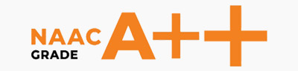
CAP404 INFORMATION SECURITY AND PRIVACY Lecture on security approaches
School of Computer Applications
Domain: AI & ML
Lovely Professional University

Slide 2
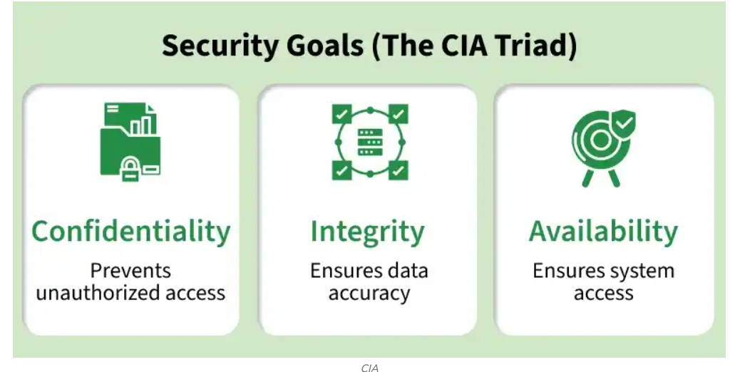

Slide 3
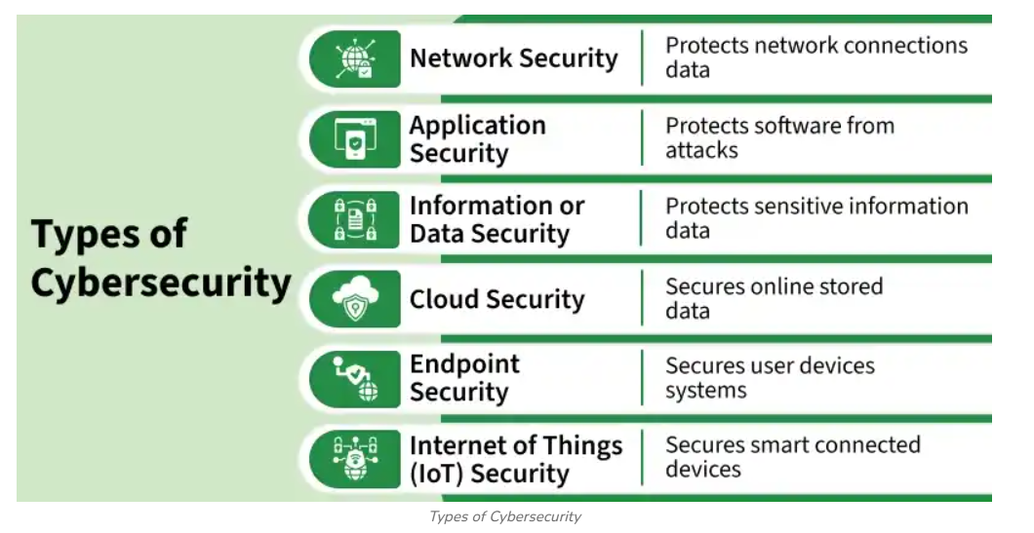

Slide 4
1. Network Security –
Protects Networks: Safeguards computer networks and connected devices from unauthorized access and cyber threats.
Controls Access: Ensures only authenticated and authorized users can access network resources.
Monitors Traffic: Detects and blocks suspicious or malicious network activity using security tools.
Secures Data: Protects data during transmission through encryption and secure communication protocols.
Uses Security Technologies: Employs firewalls, IDS/IPS (Intrusion Detection and Prevention Systems), VPNs, and network segmentation to strengthen defenses.
Ensures Availability: Maintains reliable network operations by preventing attacks, reducing downtime, and supporting business continuity.

Slide 5
2. Application Security – Key Points
Protects Applications: Secures software and web applications from cyber threats and unauthorized access.
Secure Development: Integrates security practices throughout the Software Development Life Cycle (SDLC).
Identifies Vulnerabilities: Uses code reviews, vulnerability assessments, and penetration testing to detect security flaws.
Implements Authentication: Enforces strong authentication, authorization, and session management to protect user accounts.
Applies Regular Updates: Installs security patches and software updates to fix known vulnerabilities.
Prevents Common Attacks: Defends against threats such as SQL injection, Cross-Site Scripting (XSS), Cross-Site Request Forgery (CSRF), and malware.

Slide 6
3. Identity and Access Management (IAM)
Controls User Access: Ensures only authorized users can access systems, applications, and sensitive data.
User Authentication: Verifies user identity using passwords, biometrics, or Multi-Factor Authentication (MFA).
Role-Based Access Control (RBAC): Grants permissions based on a user's role, following the principle of least privilege.
Access Monitoring: Tracks user login activities and access attempts to detect unauthorized or suspicious behavior.
Centralized Identity Management: Manages user accounts, permissions, and credentials from a single platform for improved security.
Enhances Security & Compliance: Reduces the risk of unauthorized access, insider threats, and helps organizations comply with security regulations.

Slide 7
4. Cloud Security
Protects Cloud Resources: Secures cloud applications, infrastructure, and data.
Encrypts Data: Protects data during storage and transmission.
Controls Access: Restricts access to authorized users using IAM and MFA.
Continuous Monitoring: Detects threats and suspicious activities in real time.
Ensures Compliance: Meets industry security standards and regulations.
Prevents Data Breaches: Reduces the risk of cyberattacks and unauthorized access.

Slide 8
5. Data Security
Protects Sensitive Data: Prevents unauthorized access, theft, or loss of information.
Uses Encryption: Secures data during storage and transmission.
Regular Backups: Ensures data can be recovered after failures or attacks.
Data Loss Prevention (DLP): Monitors and prevents unauthorized data sharing or leakage.
Access Control: Limits data access to authorized users only.
Maintains Data Integrity: Ensures data remains accurate, consistent, and available.

Slide 9
6. Security Awareness & Training
Educates Users: Trains employees to identify common cyber threats.
Recognizes Phishing: Helps detect phishing emails and scam websites.
Prevents Social Engineering: Raises awareness of manipulation and fraud techniques.
Promotes Strong Passwords: Encourages strong, unique passwords and Multi-Factor Authentication (MFA).
Encourages Safe Online Practices: Teaches secure browsing, email, and file-sharing habits.
Reduces Human Error: Minimizes security incidents caused by user mistakes.

Slide 10
7. Incident Response & Recovery
Detects Cyber Incidents: Identifies security breaches, attacks, and system threats quickly.
Responds Effectively: Takes immediate actions to contain and minimize damage.
Uses Response Plans: Follows predefined procedures to handle security incidents.
Performs Forensic Analysis: Investigates incidents to identify causes and prevent recurrence.
Ensures Data Recovery: Restores systems and data through backups and disaster recovery plans.
Improves Security: Learns from incidents to strengthen future defenses.

Slide 11
